Slide 1

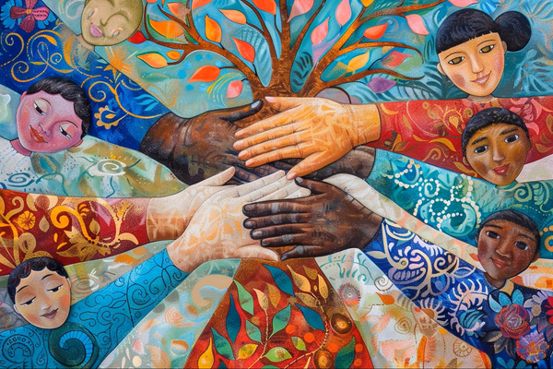

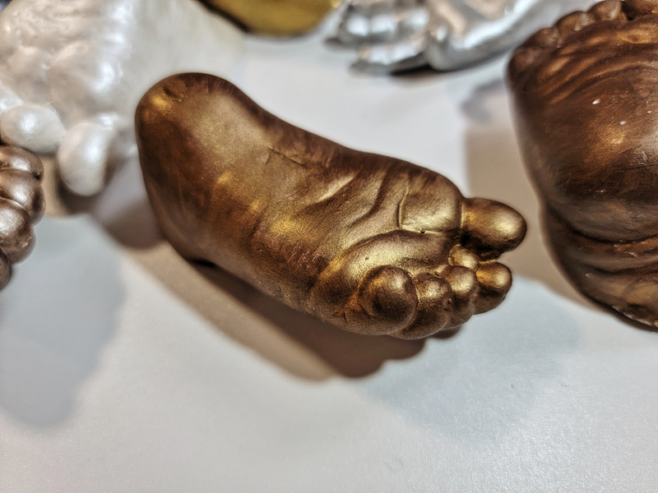
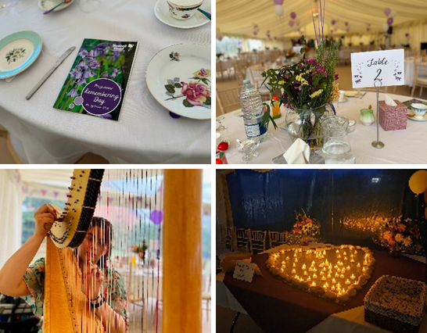
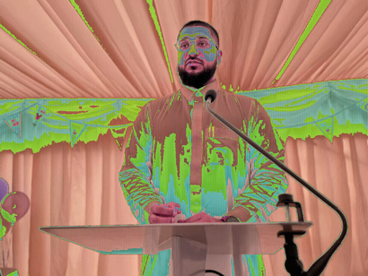

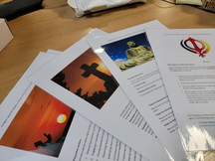
Improving bereavement support at Bluebell Wood Children’s Hospice for families from minority communities
End of life care and care after death, cultural considerations.
When discussing ethnicity in children's palliative care, the key issue is not simply demographics, but whether children and families from different ethnic backgrounds can access services equitably and receive culturally appropriate care.
A recent study in North West England found that children of South Asian ethnicity were significantly less likely to be actively seen by palliative care services than White children, despite having palliative care needs. [Lancaster University 2026]
More broadly, palliative care services in the UK have been found to be less successful in reaching people from ethnically diverse communities, who often report poorer experiences once in the system. [National Institute for Health and Care Research 2026]
At Bluebell Wood Children’s Hospice, we support around 350 families from across South Yorkshire, Derbyshire, Nottinghamshire, North Lincolnshire and are inviting families to provide feedback following receiving end of life and care after death services. We hope to better understand their experience, identify opportunities for improvement, pursue the highest standards of compassionate care, and ensure the voices of bereaved families inform future service development. Feedback helps us better understand and meet the diverse cultural, religious, spiritual, and individual needs of the families we support, ensuring our care remains inclusive, respectful, and responsive to each family's wishes and traditions.
Memory Work
Memory work is an integral part of the bereavement care offered to families. This includes fingerprint moulds, hand print canvases and 3D moulds of hands and feet. We have recently expanded the options for colour finishes to recognise the diversity in skin tones and promote inclusivity for families of all ethnicities.
We have also increased sibling involvement in creation of memory work (where appropriate), recognising that bereaved siblings sometimes live in the shadow of the grief of the adults around them.
Remembering Day
Enhancing our longstanding remembering day, we have invited faith representatives to attend and participate in the delivery of the day.
This deliberately seeks to ensure that people of different cultures and ethnicities see themselves represented in the service providers to enhance belonging and inclusion. We have also introduced a sibling memory table at remembering day, seeking to enhance their space to share their love and grief.
The journey from Bluebell Wood
We have introduced a discreet individualised ‘journey from Bluebell Wood’ to mark the moment when a young person leaves our care after death facilities to transfer into the care of funeral directors. This includes the opportunity for families to select a poem or faith-based reading and a small, environmentally-friendly token of departure, recognising that importance of people’s faiths and spirituality at all times, especially at end of life.
Translated materials
For those families whose first language is not English, our bereavement team have created bespoke translated materials in languages that we have identified across the demographic of the families we support. Promotion of individual choice and autonomy at end of life and in care after death is a central component of respecting the individual in their most private and vulnerable moments. Having materials that explain the choices available to them in their first language is crucial to communicating value and respect for the individual, reducing barriers to excellence in care.

Slide 2
References:
https://www.kcl.ac.uk/nmpc/assets/rr-project-3-case-study-betterprovision-policybrief-6may2026.pdf
https://research.lancaster-university.uk/en/publications/how-many-children-have-palliative-care-needs-and-which-of-them-ar/

